Slide 1
Competition and Bidding Data as an Indicator of the Health of the U.S. Defense Industrial Base
Principal Investigator: Andrew Hunter
Researchers: Jesse Ellman and Gregory Sanders
May 13, 2015
Defense-Industrial Initiatives Group
Center for Strategic & International Studies
202-775-3183
www.csis.org/diig

Slide 2
Methodology
This slide describes the overall methodology employed to develop this dataset.
The Federal Procurement Data System (FPDS) was the primary source for this electronic data summary for 2000-2014.
Federal regulations require only that all unclassified prime contracts worth $2,500 and above be reported to FPDS.
FPDS data are constantly being updated, including those for back years. As a consequence, the dollar totals for a given year may have changed since the data was downloaded.
Overseas Contingency Operations funding and other supplemental appropriations are not separately classified in FPDS.
CSIS defines “effective competition” as competitively sourced contracts that receive two or more offers.
All dollar figures are in constant 2014 dollars.

Slide 3
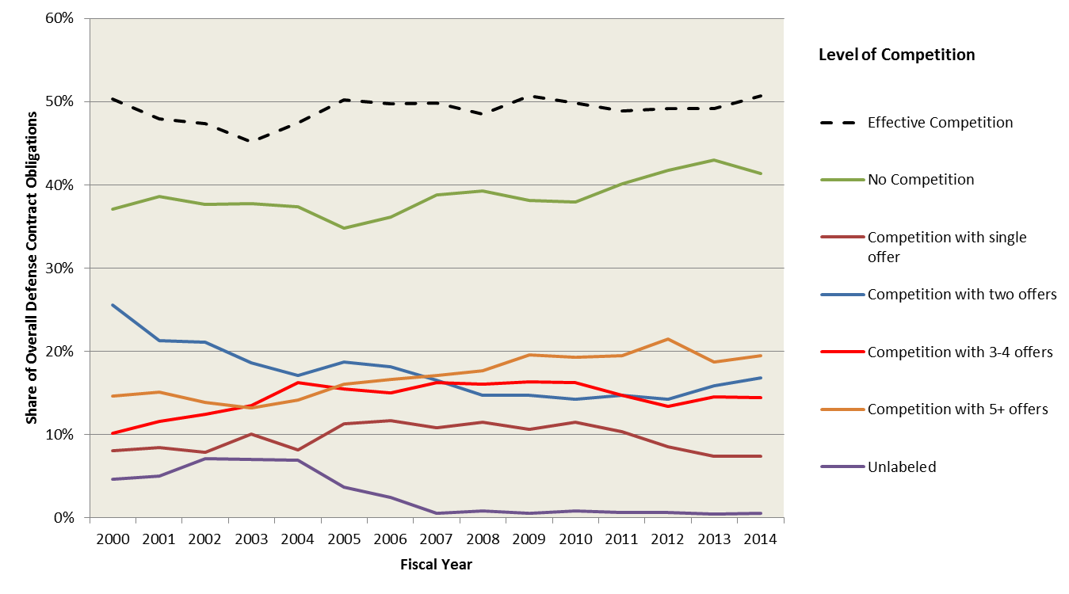
Level of Competition for Overall Defense Contract Obligations, 2000-2014

Slide 4
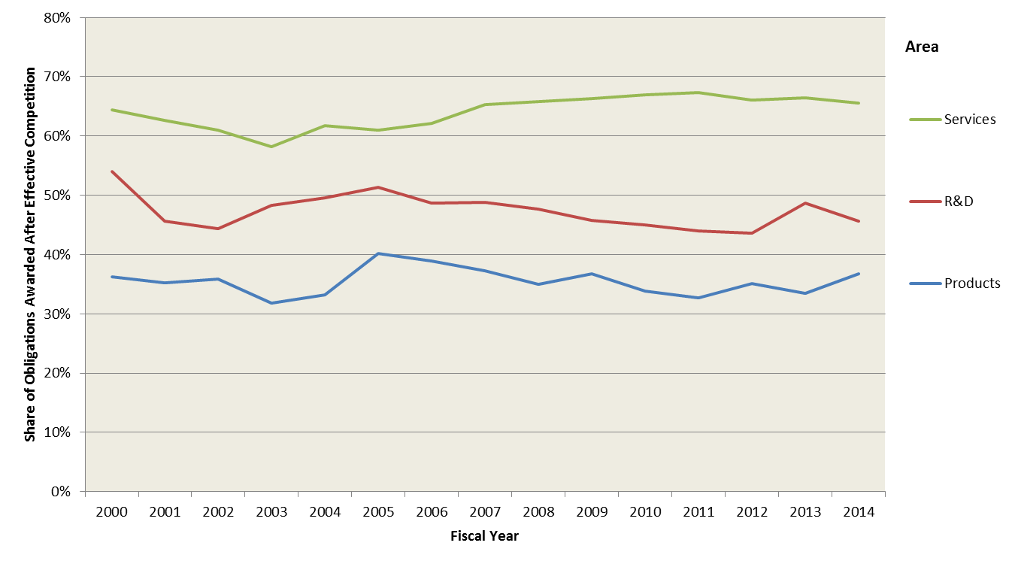
Rate of Effective Competition for Defense Contract Obligations by Area, 2000-2014

Slide 5
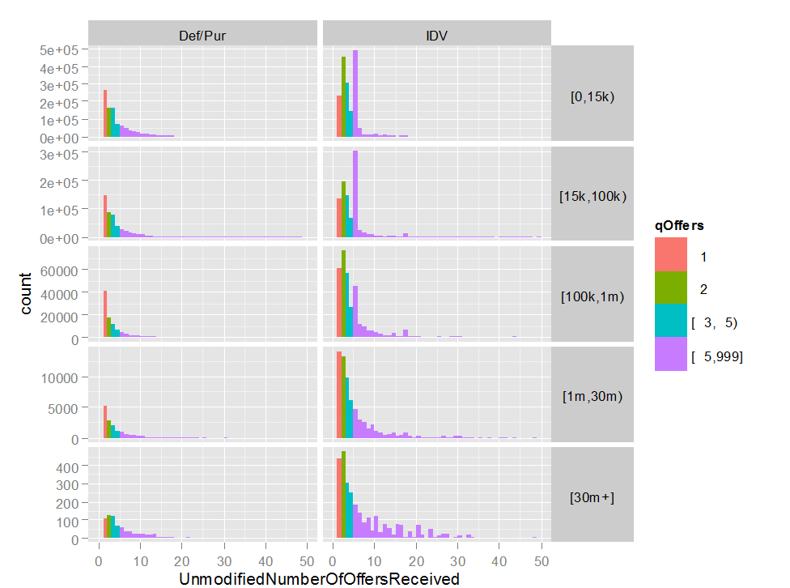
Number of Offers Received by Contract Size and Contract Vehicle, 2014

Slide 6
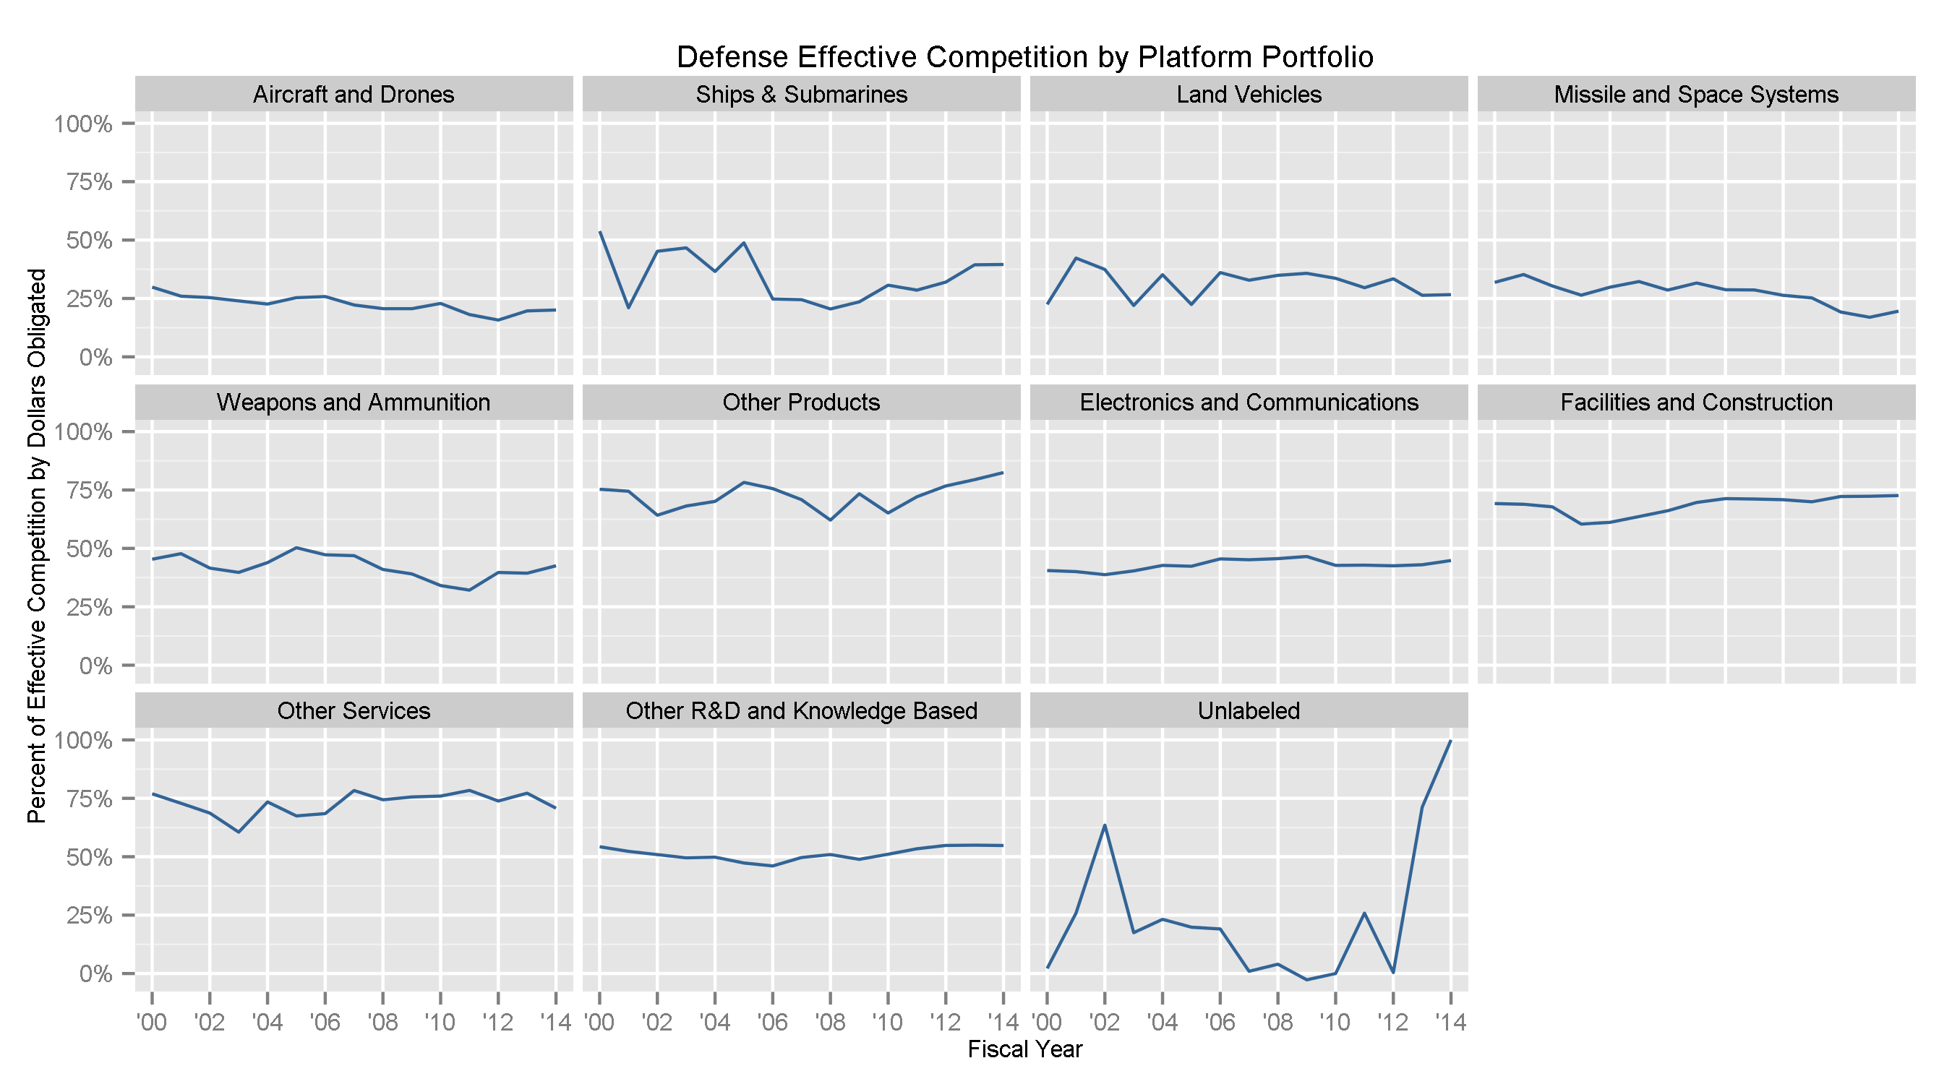
Rate of Effective Competition by Platform Portfolio, 2000-2014

Slide 7
Modeling DoD Effective Competition Rates using Regression
In order to delve deeper into trends in competition for DoD contracts, CSIS constructed a regression-based model, using competition data from FY2000-FY2013, to predict levels of effective competition in FY2014 at two levels of DoD contracting:
Major Contracting Command (MCC): Going a level below the usual analytic level of “component”, this breakdown allows for analysis of how successful different major contracting commands have been in promoting effective competition relative to the goods or services for which they are contracting and the types of contracts for which they are responsible. This is done by using each MCC as an observation and aggregating the data from each MCC for each variable over the time period from 2000 to 2013.
Place of Performance: This breakdown examines in which state a contract is to be performed. This is done by using each state as an observation and aggregating the data from each state for each variable over the time period from 2000 to 2013. This can provide indications of the vibrancy of the industrial base available to perform contracts activity that takes place within a particular state.

Slide 8
Major Contracting Command: Variables
Variables that correlate with lower rate of effective competition:
Greater percentage of contract obligations related to Aircraft & Drone programs (pAir); Missile & Space programs (pMnS); Weapons & Ammunition programs (pWnA); and Electronics & Communications programs (pEnC).
Greater mix of contract obligations for products and services (pService:pProduct). As the contracting portfolio becomes more mixed, rates of effective competition decrease.
Percentage of contract obligations for services and awarded under IDV contract types (pService:pIDV). Ccompetition decreases when both increase.
Variables that correlate with higher rate of effective competition:
Greater percentage of contract obligations awarded under Indefinite Delivery Vehicle (IDV) contract types (pIDV).
Greater percentage of contract obligations awarded for services (pService).
Greater mix of contracting obligations for products and services, along with greater percentage of contracts awarded under IDV contract types (pService:pProduct:pIDV).

Slide 9
Major Command Regression: Statistical Details
The following variables have been evaluated as being part of a statistically significant causal model for competition; however, significance varies across Variables.

Slide 10
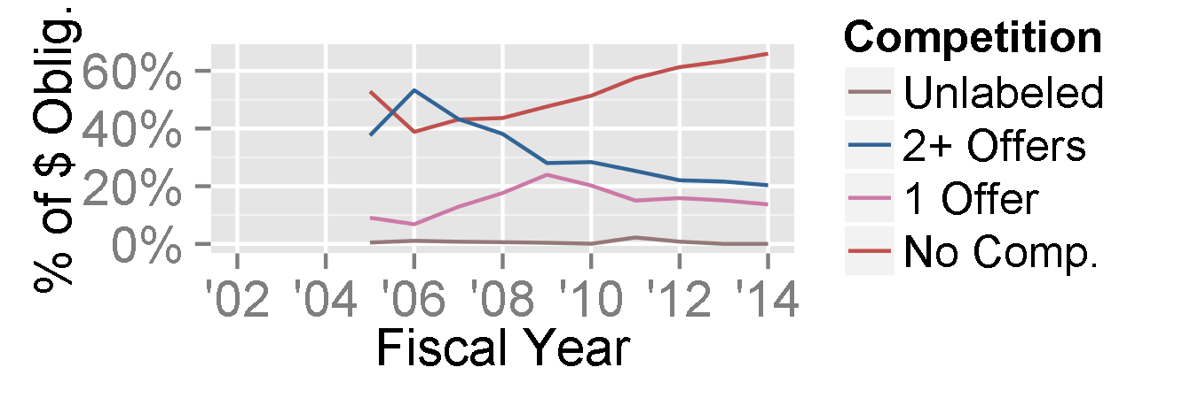
DLA Aviation
Total 2014 Contract Obligations: $4.3 billion
“Estimated” 2014 Effective Competition Rate: 42 percent
Actual 2014 Effective Competition Rate: 20 percent
The DLA Aviation rate of effective competition for Aircraft & Drones contract obligations was low in 2014 (17 percent), but that is only slightly lower than the rate for Aircraft & Drones contracts in DoD overall (21 percent).
Within Aircraft & Drones, only 12 percent of DLA Aviation contract obligations for products categorized as “Engines & Power Plants” were awarded after effective competition, compared to 37 percent for DoD overall.
By contrast, the rate of effective competition for Electronics & Communications within DLA Aviation (22 percent) is significantly lower than the rate for DoD overall (35 percent).
While 73 percent of overall DoD contract obligations for products and services categorized as “Facilities & Construction” (F&C) are awarded after effective competition, that rate is only 36 percent for F&C contract obligations within DLA Aviation.

Slide 11
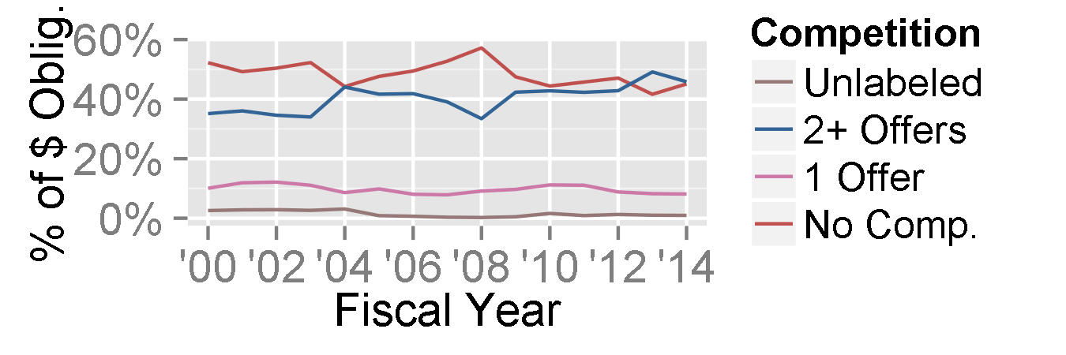
Army Materiel Command (AMC)
Total 2014 Contract Obligations: $43.6 billion
“Estimated” 2014 Effective Competition Rate: 34 percent
Actual 2014 Effective Competition Rate: 46 percent
Based solely on the correlative variables for AMC, AMC effective competition rates being higher than “estimated” in 2014 seems unusual: a nearly even mix of products and services, as well as higher-than-average shares of obligations going to Aircraft & Drones and Electronics & Communications, correlate with lower rates of competition.
The main driver of the higher than “estimated” rate of effective competition for AMC seems to be in the rate of effective competition for professional, administrative, and management support services (PAMS): PAMS account for nearly a quarter of AMC’s contract portfolio, and 66 percent were awarded after effective competition, compared to 36 percent for DoD overall.

Slide 12
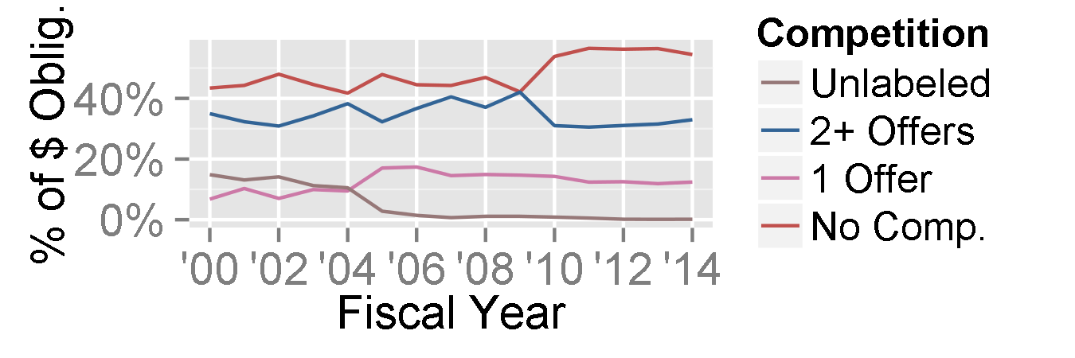
Naval Supply Systems Command (NAVSUP)
Total 2014 Contract Obligations: $7.1 billion
“Estimated” 2014 Effective Competition Rate: 52 percent
Actual 2014 Effective Competition Rate: 33 percent
The relevant correlative variables for NAVSUP are a mixed bag:
A relatively even mix of products and services, along with slightly higher-than-average shares of obligations going to Aircraft & Drones and Electronics & Communications, correlate with lower rates of effective competition.
Meanwhile, higher-than-average usage of IDV contract types, especially alongside the aforementioned even mix of products and services, correlate with higher rates of effective competition.
Only 3 percent of NAVSUP contract obligations for Aircraft & Drones in 2014 were awarded after effective competition, compared to 21 percent for DoD overall.
Only 23 percent of NAVSUP contract obligations for Electronics & Communications were awarded after effective competition, compared to 45 percent for DoD overall.

Slide 13
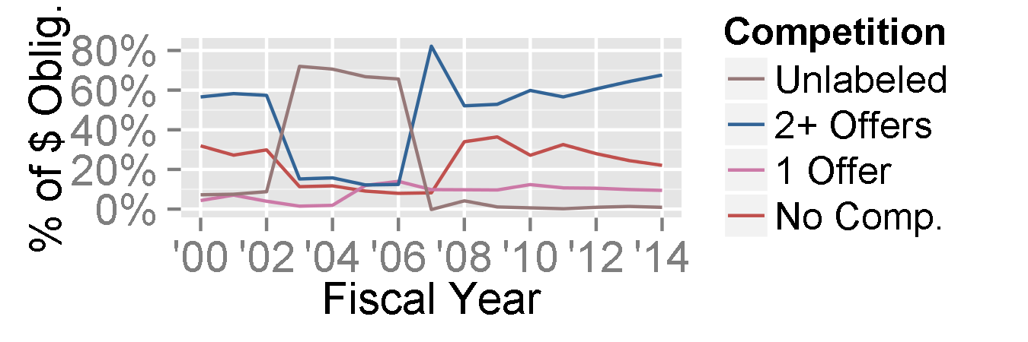
Air Force Materiel Command (AFMC)
Total 2014 Contract Obligations: $36.7 billion
“Estimated” 2014 Effective Competition Rate: 30 percent
Actual 2014 Effective Competition Rate: 30 percent
AFMC has a high percentage of contract obligations going to Aircraft & Drones (though, at 38 percent, not as high as one might assume), which correlates with lower rates of effective competition.
AFMC has a relatively even mix of products and services in its contracting portfolio, which similarly correlates with lower competition rates.
Only 26 percent of AFMC contract obligations for PAMS in 2014 were awarded after effective competition, compared to 36 percent for DoD overall. By contrast, for AFMC equipment-related services (ERS), 33 percent of contract obligations were awarded after effective competition, compared to 26 percent overall.
This lack of unidirectional deviations from “estimated” rates of competition is likely a significant factor enabling the predictive model to accurately estimate 2014 effective competition rates.

Slide 14
Place of Performance (States): Variables
Variables that correlate with lower rate of effective competition:
Greater percentage of contract obligations awarded for products (pProduct),
Greater percentage of contract obligations related to Aircraft & Drone programs (pAir); Missile & Space programs (pMnS); Ships programs (pVessel); and Electronics & Communications (E&C) programs (pEnC).
Variables that correlate with greater rate of effective competition:
Greater percentage of contract obligations awarded under Indefinite Delivery Vehicle (IDV) contract types.
Greater percentage of contract obligations awarded for both products and Electronics & Communications (pProducts:pEnC) (competition increases when both increase).

Slide 15
U.S. State Regression: Details
The following variables have been evaluated as being part of a statistically significant causal model for competition in U.S. states; however, significance varies across variables.

Slide 16
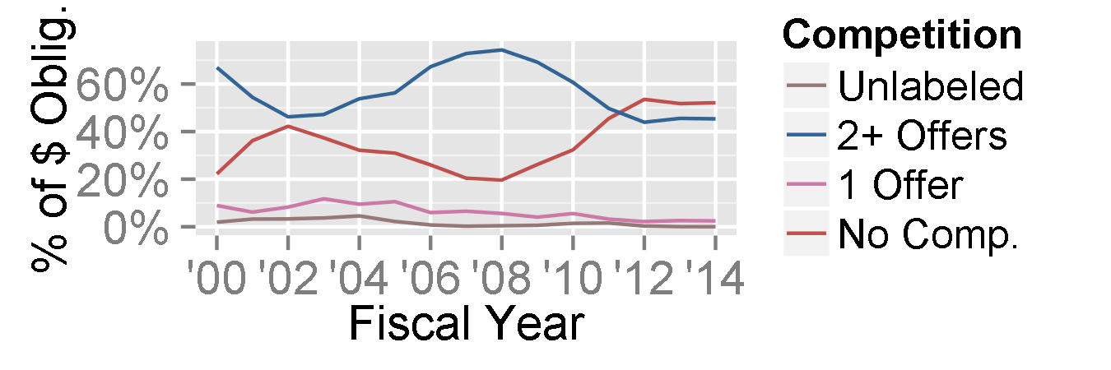
Washington
Total 2014 Contract Obligations: $7.5 billion
“Estimated” 2014 Effective Competition Rate: 13 percent
Actual 2014 Effective Competition Rate: 45 percent (Upper limit of 95% confidence interval: 37 percent)
A high share (66 percent) of obligations for contracts performed in Washington go to Aircraft & Drones programs, and a below-average share (26 percent) of Washington contract obligations are IDV-type contracts, which both correlate with lower rates of effective competition.
The source of the higher-than-“estimated“ rate of competition for contracts performed in Washington appears to be tied to Aircraft-related products: while only 10 percent of those contract obligations were awarded after effective competition in 2014 nationwide, 35 percent of those contracts performed in Washington were awarded after effective competition.
Due to poor data labeling, the competed portion of Washington’s Aircraft contract obligations are labeled as being associated with the Shillelagh Missile, a 1970s Army anti-tank missile program.
88 percent of Washington facilities-related services and construction (FRS&C) contract obligations were awarded after effective competition in 2014, compared to 70 percent for DoD overall, with nearly 90 percent of the effectively competed Washington FRS&C contracts receiving 3 or more offers.

Slide 17
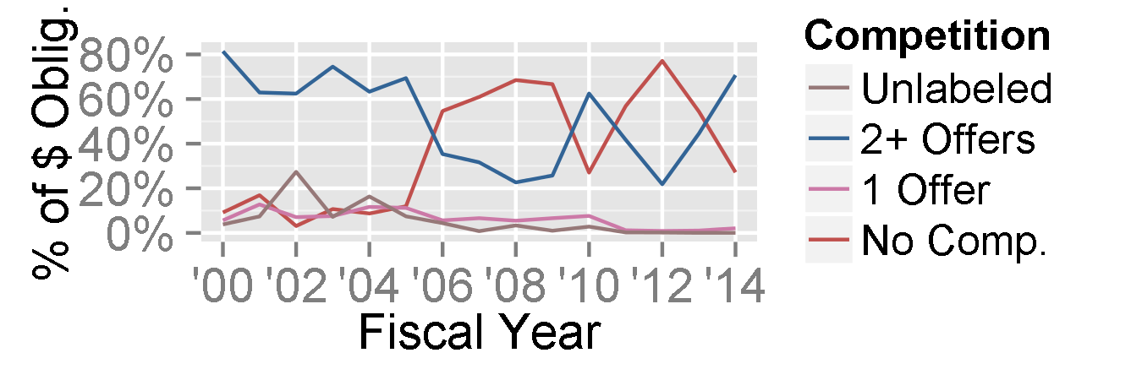
Mississippi
Total 2014 Contract Obligations: $2.3 billion
“Estimated” 2014 Effective Competition Rate: 44 percent
Actual 2014 Effective Competition Rate: 71 percent (Upper limit of 95% confidence interval: 67 percent)
Nearly three-quarters of Ships contract obligations in Mississippi were awarded after effective competition in 2014 (almost entirely with only 2 offers), compared to 37 percent nationwide.
Approximately 30 percent of contract obligations performed in Mississippi were related to Aircraft programs in 2014. While only 20 percent of such contracts were awarded after effective competition nationwide, 76 percent of Aircraft contract obligations in Mississippi were awarded after effective competition.
Most of the Aircraft contract obligations in Mississippi were for “logistics support services”, likely related to Columbus Air Force Base, a major Air Force pilot training installation.

Slide 18
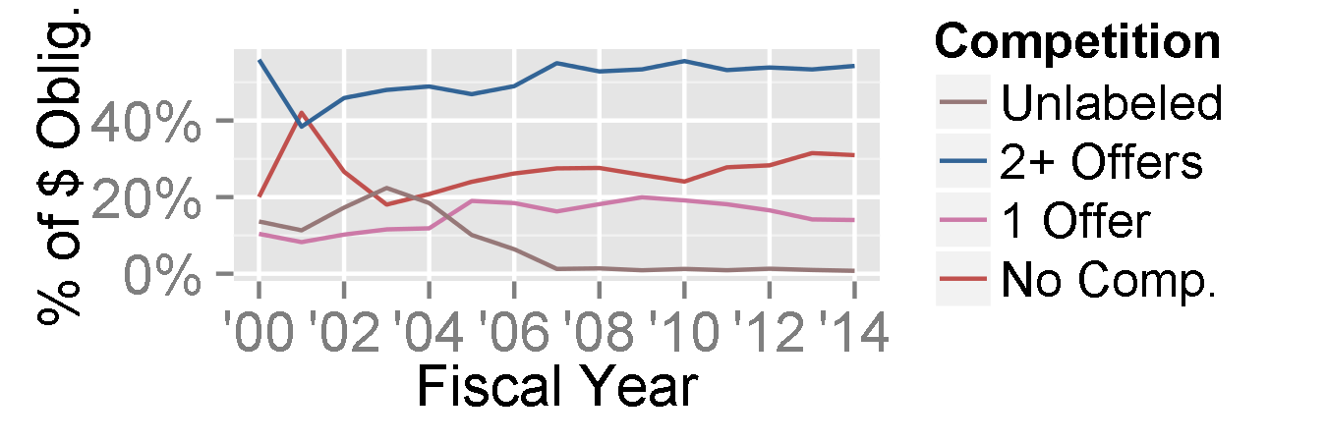
Virginia
Total 2014 Contract Obligations: $33.6 billion
“Estimated” 2014 Effective Competition Rate: 54 percent
Actual 2014 Effective Competition Rate: 55 percent
Only 32 percent of obligations for contracts performed in Virginia were for products, compared to 41 percent overall, which would tend to correlate with higher rates of effective competition. Similarly, 67 percent of Virginia contract obligations were awarded under IDV contract types, notably higher than the rate for DoD overall.
The market for PAMS in Virginia is significantly more competitive than it is nationwide: 61 percent of PAMS contract obligations performed in Virginia were awarded after effective competition, compared to 36 percent nationwide.
For R&D contract obligations performed in Virginia, 36 percent awarded after competitions received only a single offer - over twice the rate for R&D nationwide. As a result, the rate of effective competition for R&D contracts performed in Virginia was only 32 percent in 2014, compared to 46 percent nationwide.
Given the heavy concentration of major R&D vendors in Virginia, this high rate of single-offer competition is likely masking contracts that would be more properly classified as non-competitive.

